Slide 1
Smart devices sensors programming
Asistentas : Simonas Česnauskas

Slide 2
Transistors and their types
A transistor is a semiconductor device commonly used to amplify electronic signals or as an electrically operated switch to direct signals. A transistor is a fundamental part of computers and other modern electronic devices. Invented back in 1948.

Slide 3
Transistors types
BJT
FET
NPN
PNP
JFET
MOSFET
N-channel
P-channel
N-channel
P-channel

Slide 4
BJT - Bipolar Junction Transistor
Has 3 terminals. Base (B), Emitter (E), Collector (C).
These are electricall curent operated components (I).
If a small current is applied to the component base (contact B), then the transistor can pass a significantly higher current traveling through the remaining contacts (through which, depending on whether it is PNP or NPN).
BJT transistors can operate in 3 operating modes, which will be reviewed below.

Slide 5
BJT transistor operating modes
Cut-off mode - in this mode the transistor is in the OFF state.
Active Mode - In this mode, the component acts as an amplifier.
Saturation mode - in this mode the transistor is as if it is in the full ON state.

Slide 6
BJT NPN transistors
This type of component consists of two N-type semiconductors separated by a thin layer of a P-type semiconductor.
In an NPN transistor, most of the charge carriers are electrons and a minority are holes. Electrons flowing from the emitter (E) to the collector (C) form a current flow at the base (B) contact of the transistor.
In a transistor, even a small current flowing at the base (B) can cause a large amount of current to flow from the emitter terminal to the collectors. Currently, the most commonly used BJTs are NPN transistors because of higher electron mobility compared to hole mobility..
When the transistor is in the OFF position, it conducts current.

Slide 7
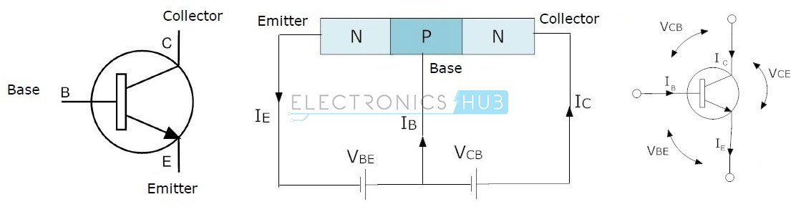
BJT NPN transistors

Slide 8
BJT PNP transistors
This type of component consists of two P-type semiconductors separated by a thin layer of N-type semiconductor.
In these transistors, most of the charge carriers are holes and a minority are electrons.
In this transistor, the arrow symbol in the diagram indicates the normal current flow. The direction of current flow in this transistor is from the emitter terminal to the collector terminal.
When the transistor is in the OFF state, it does not leak currents through itself.

Slide 9
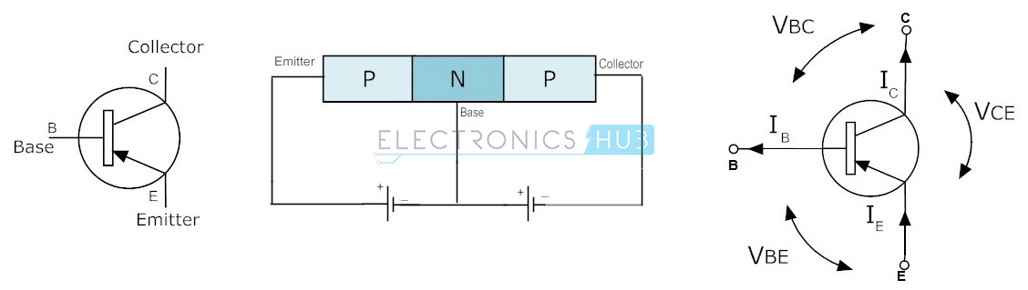
BJT PNP transistors

Slide 10
FET - Field Effect Transistor
The field effect transistor consists of 3 contacts, Gate (G), Source (S) and Drain (D). Unlike bipolar transistors, FETs are voltage controlled devices. The voltage connected to the Gate contact controls the current flow from the Source to the Drain contact of the transistor. Field effect transistors have very high input impedances, ranging from a few megaohms (MΩ) to much, much higher values..
Due to this high input resistance, very low currents flow through them. (According to the law of ohm, the current is inversely affected by the value of the circuit resistance. If the resistance is high, the current is very low.) Thus, both types of FET draw very little current from the circuit power supply.

Slide 11
FET - Field Effect Transistor
Thus, this is ideal because they do not interfere with the original circuit batteries to which they are connected. They do not overload the power supply. The disadvantage of FETs is that they do not provide the same amplification that could be obtained from bipolar transistors.
Bipolar transistors are similar at the time they are designed with higher gain, although on the other hand FETs are better at times when they are designed with lower load, and are easier to manufacture. There are two main types of field effect transistors: JFET and MOSFET. JFET and MOSFET are very similar, but the MOSFET input resistance values are even higher than JFET. This creates even less load on the circuit.

Slide 12
JFET – Junction Field Effect transistor
It is a voltage controlled device and does not use any current to connect it. When voltage is connected between the Gate and Source terminals, it controls the current flow between the Source and Drain contacts of the JFET transistor.
A JUGFET or JFET has no PN connectors, but is replaced by a narrow portion of a high-resistance semiconductor material that forms an N- or P-type silicon “channel” through which most carriers could flow with two electrical connectors at both ends, commonly referred to as the Drain and Gate.

Slide 13
JFET – Junction Field Effect transistor
There are two basic configurations of a junction field effect transistor: an N-channel JFET and a P-channel JFET. The N-channel JFET channel is supplemented with donor impurities, which means that the current flow through the channel is negative (which can also be understood from the name of the N-channel) in the form of electrons. These transistors are available in both P and N channel types.

Slide 14
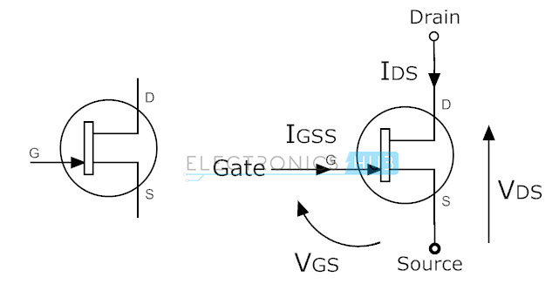
N-channel JFET

Slide 15
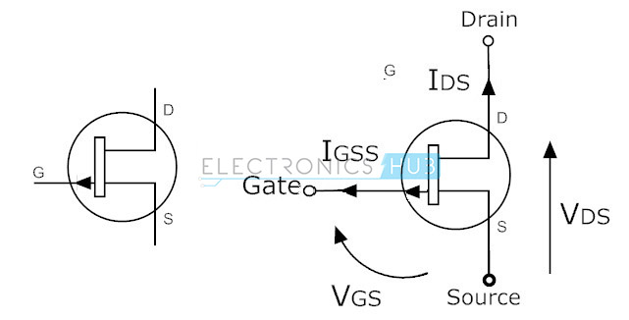
P-channel JFET

Slide 16
MOSFET – Metal Oxide Semiconductor Field Effect Transistor
This is the most commonly used type among all types of transistors. As the name suggests, it has a metal Drain clamp. This transistor has four terminals (contacts) such as Source, Drain, Gate and Substrate or Body.
MOSFETs are most commonly used in low power circuits, especially in the design of chips. These transistors are of two types, such as depletion and enhancement. In addition, these types are further subdivided into P and N channel types.

Slide 17
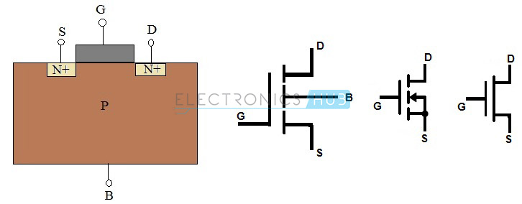
N-channel MOSFET

Slide 18
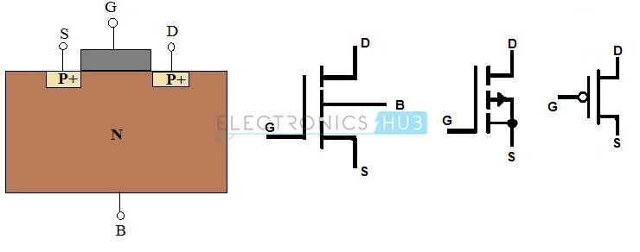
P-channel MOSFET

Slide 19
Diodes and their types
Diodes are electronic components that act as a non-return valve, meaning they allow current to flow in one direction. These diodes are made of semiconductor materials such as germanium, silicon and selenium. The operation of a diode can be classified in two ways, if it conducts current, then it is directed forward, otherwise it is inverted.
Different types of diodes have different voltage requirements. Silicon diodes require a voltage of 0.7v, and germanium - 0.3v. In a silicon diode, a dark band indicates the cathode terminal and the other terminal is the anode. Diodes are commonly used as reverse connection protection and short-term protection. There are many types of diodes, but the most relevant ones will be listed below.

Slide 20
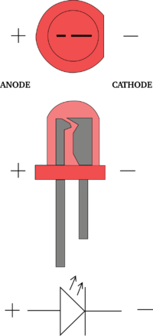
LED diodes
These diodes convert electricity into light energy. They undergo an electroluminescent process in which holes and electrons are recombined to produce energy in the form of light.

Slide 21
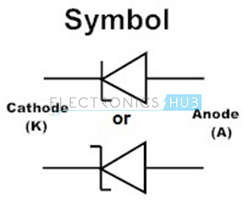
Zenre diodes
It is a passive element operating on the principle of zener decomposition. It is similar to a conventional diode that passes voltage directly through itself in one direction. However, the zener diode also conducts current in the reverse direction when the applied voltage reaches a critical point. It is designed to prevent voltage spikes that can severely damage other components. It acts as a voltage regulator.

Slide 22
Signal diodes
It is a small device with disproportionate characteristics and is most commonly used in high frequency and very low current devices such as radios or televisions. To protect the diode from contamination, it is enveloped in glass, which is why it is also called a glass passivated diode, which is widely used as 1N4148.
The appearance of the signal diode is very small compared to the power diode. To indicate the cathode terminal, one edge is marked in black or red. The signal diode is most efficient when working in high frequency circuits.

Slide 23
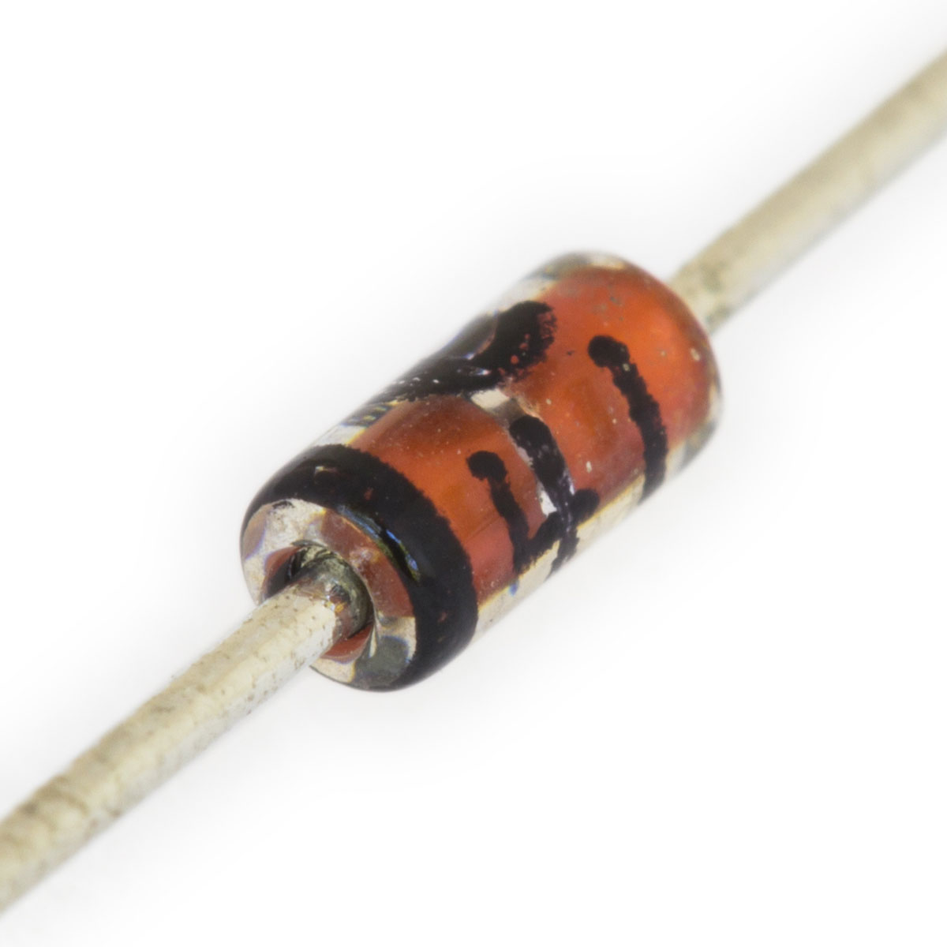
Signal diodes

Slide 24
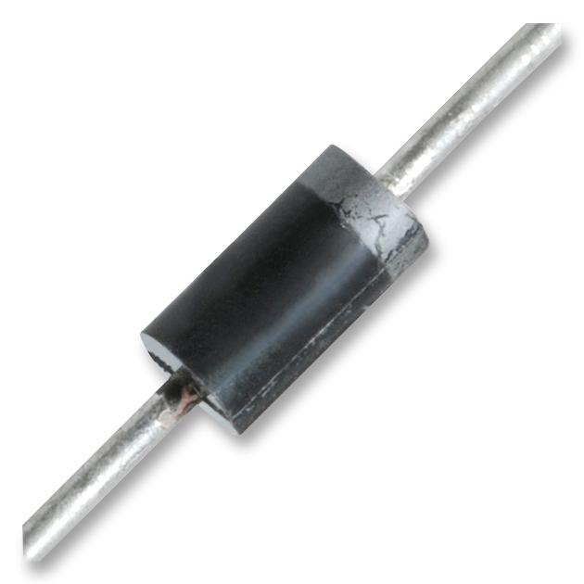
Power diodes
These diodes have a large PN connector layer. Thus, the transformation of alternating current into direct voltage is common in their use. It also increases the power transmitted and the resistance to reverse transmission (puncture). Such signals will also interfere with the functional operating point. As a result, it is not suitable for use in high-frequency devices.

Slide 25
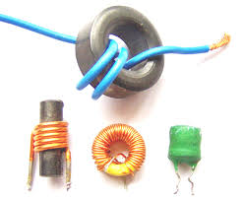
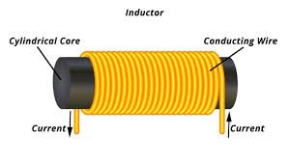
Coils and their types
A coil, a choke, or a reactor, is a passive electrical component of two terminals that, like a capacitor, stores energy in a magnetic field when an electric current flows through it. The coil usually consists of an insulated wire wound into a coil which has a core around which it is wound.

Slide 26
Air core coils
Ceramic core coils are also called "Air core coils". Ceramics is the most commonly used material for making coil cores. The coefficient of thermal expansion of ceramics is very low, so even at different operating temperatures, the inductance of the coil is stable. Because the ceramic does not have magnetic properties, the inductance of the coil does not increase due to the permeability of the core material.
The main purpose of this core is to give the shape of a coil. In some cases, the core will also provide a structure to hold the terminals. The main advantage of these inductors is very low core loss, high quality factor. They are mainly used in high frequency devices where low inductance values are required.

Slide 27
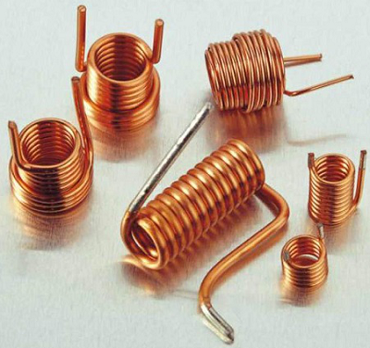
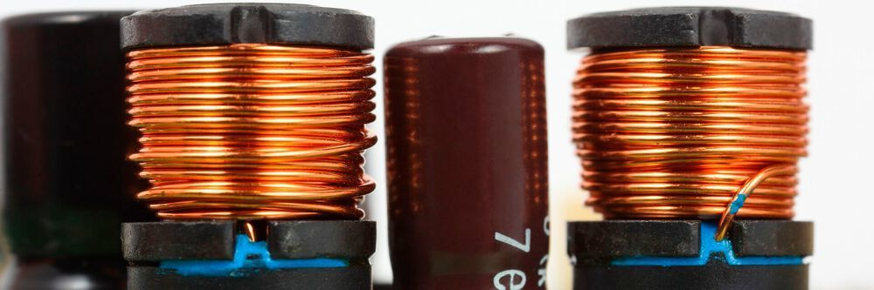
Air core coils

Slide 28
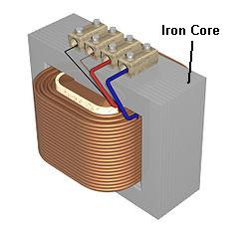
Iron core coils
In situations where small inductors are required, iron core inductors are the best choice. These inductors have high power and high inductance value, but are limited by high frequency capacities. Most are used in audio equipment. Compared to other inductors, their applicability is very limited.

Slide 29
Ferrite core coils
There are mainly two types of ferrite cores, these are soft and hard ferrite cores. Ferrite is classified according to the ability of a magnetic field to demagnetize it from a state of full saturation to zero.

Slide 30
Soft ferrite
These materials can change their magnetization polarity without any particular amount of energy required to change the magnetic polarity.

Slide 31
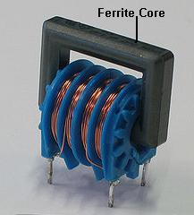
Hard ferrite
They are also called permanent magnets. Consequently, they will retain the polarity of the magnetization even after removing the magnetic field.
The ferrite core inductor will help to improve the performance of the inductor (coil) by increasing the throughput of the coil, which increases the value of the inductance. The level of permeability of the ferrite core used in the coils will depend on the ferrite material. Depending on the ferrite material, this level of permeability ranges from 20 to 15,000. Thus, the inductance is very high in a ferrite core compared to an inductor with an air core.

Slide 32
Toroids
The wire is wound on a core whose surface is in the shape of a ring or a donut. Typically, the core consists of different materials such as ferrite, iron powder, and the like. This inductor has high efficiency due to its round shape and fast saturation.
Its layout provides minimal magnetic field loss, which helps prevent the magnetic field from intersecting with other devices. It is characterized by high energy transmission efficiency and high inductance values when applied in low frequency circuits. These inductors are mainly used in medical devices, switching regulators, air conditioners, refrigerators, telecommunication and musical instruments, etc.

Slide 33
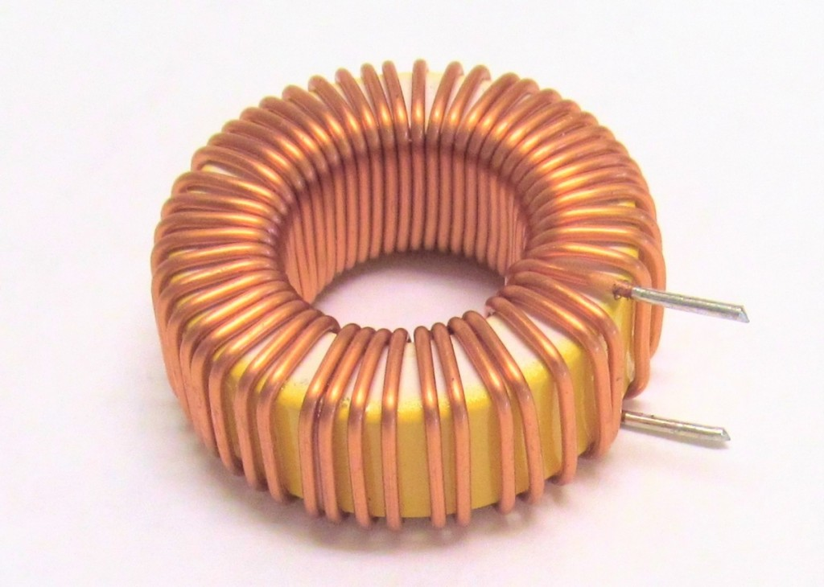
Toroids

Slide 34
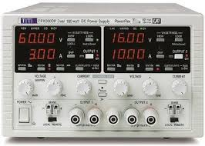
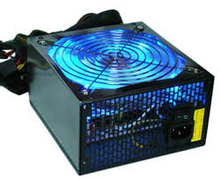
Power supplies
A power source is an electrical device that supplies electricity to an electrical load. The main function of a power supply is to convert electricity from the source into a signal with the proper voltage, current, and frequency to power the load. Therefore, power supplies are sometimes referred to as power converters. Some power supplies are separate, separate pieces of equipment, while others are built into the devices they power.

Slide 35
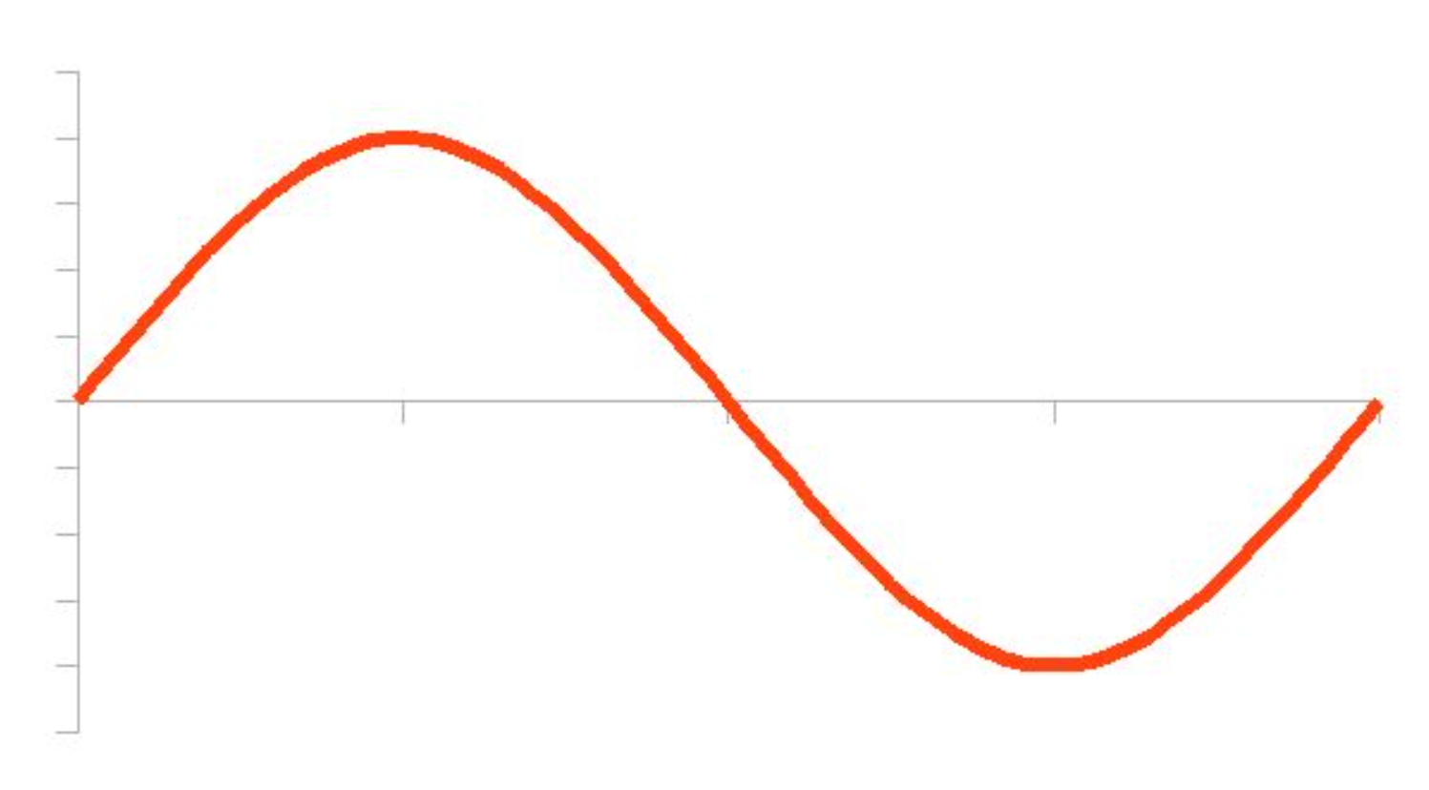
Alternating current (AC)
Alternating current (AC) is an exceptional case of regularly alternating current. The current voltage passes through zero, alternately, reaching positive and negative values, determined in a repeatable manner. One complete cycle of value changes is called a period, so that type of current is also called periodic. Its graph is presented in the form of a sinusoid.

Slide 36
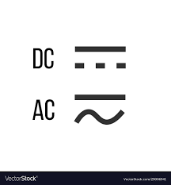
Kintamoji elektros srovė (AC)
The main parameters describing the alternating current are period, frequency (expressed in Hertz) and amplitude. AC is being used on power lines around the world. For powering all devices marked with the AC symbol and the sinusoidal symbol. Although voltage and frequency values may vary from country to country (e.g., USA is 110 V at 60 Hz).

Slide 37
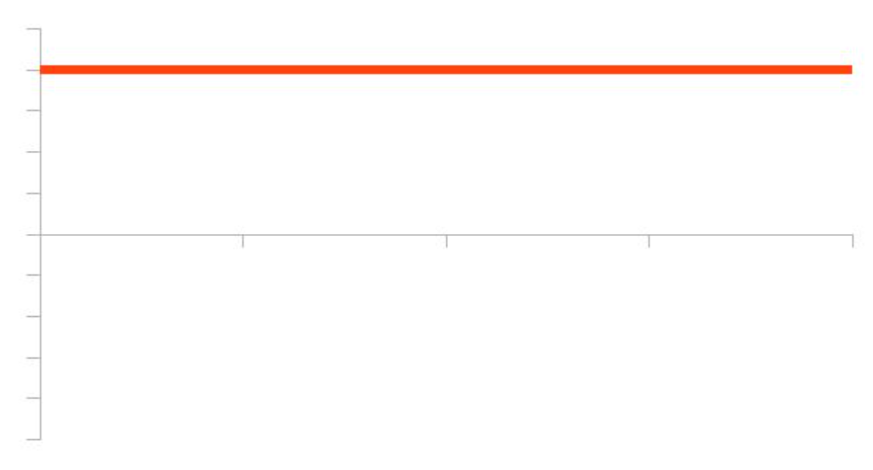
Direct current (DC)
Direct current (DC), unlike alternating current, has two poles - negative and positive. There is a potential difference between them, that is, tension. By convention, both electricity loads move from the positive pole to the negative pole, although in reality the opposite is true. The DC diagram is a straight line.

Slide 38
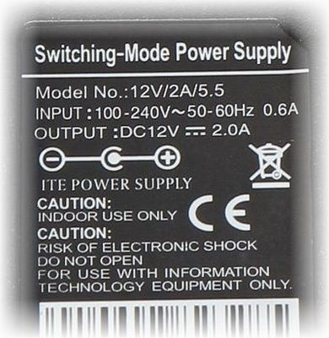
Direct current (DC)
The main direct current source is power supplies and galvanic cells (i.e., batteries and accumulators). Most electronic devices are specifically powered by direct current. It can be obtained without any problems through power supplies and rectifiers, directly from an AC outlet that carries AC power.

Slide 39
Electronic circuits
Electronics are distinguished by many types and specification schemes. However, the meaning of all of them remains similar - to explain the operation, structure, logic and the like of the device. The following are an overview of several types of schemes you may encounter.

Slide 40

Electrical schematics
Wiring diagrams do not reflect the actual arrangement of components in the device, but usually have a certain arrangement of components.
They specify which contacts of the component used are connected to the next component and which are connected to the power supply.
Thus, electrical schematics indicate the paths of electricity flow.

Slide 41
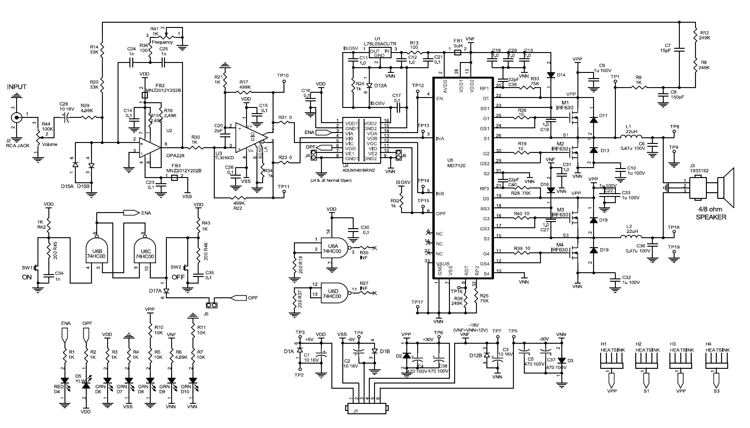
Electrical schematics

Slide 42
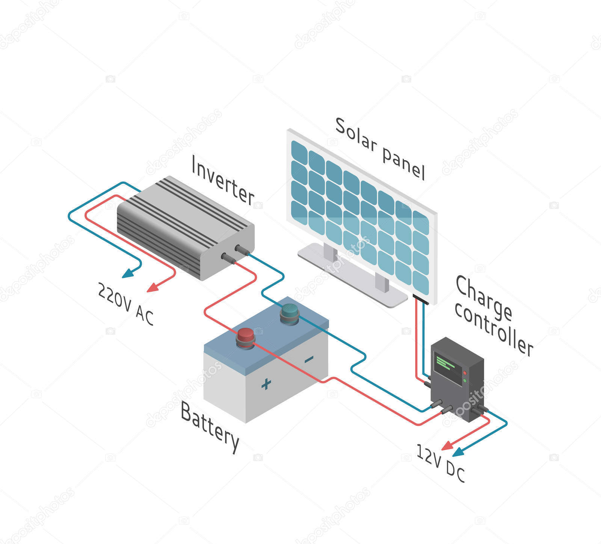
Wiring diagrams
Wiring diagrams are usually used when the device consists of separate modules that have certain contacts that must be connected to both the power supply and each other.
So wiring diagrams specify exactly which contacts are connected, where and to whom.

Slide 43
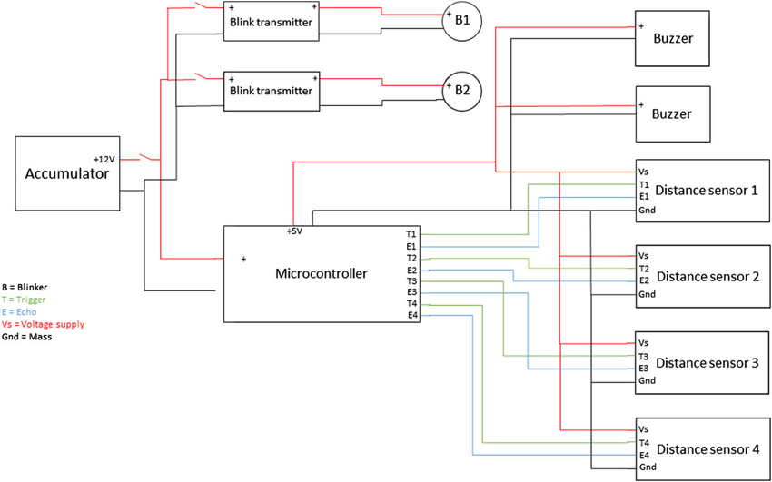
Wiring diagrams

Slide 44
Structure diagrams
Layout diagrams are usually the initial stage in the design of a device because in them polarity, and terminal connection does not mater.
The essence of the structure diagram is the connection logic, in order to graphically represent which block is connected to what.

Slide 45
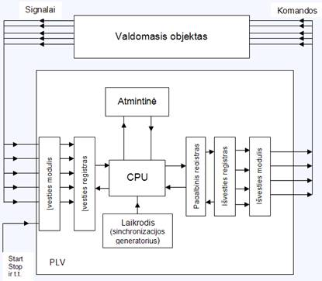
Structure diagrams

Slide 46
The devices that are used in electronics
Below we will review the basic devices, the tools that are most commonly used in electronics.

Slide 47
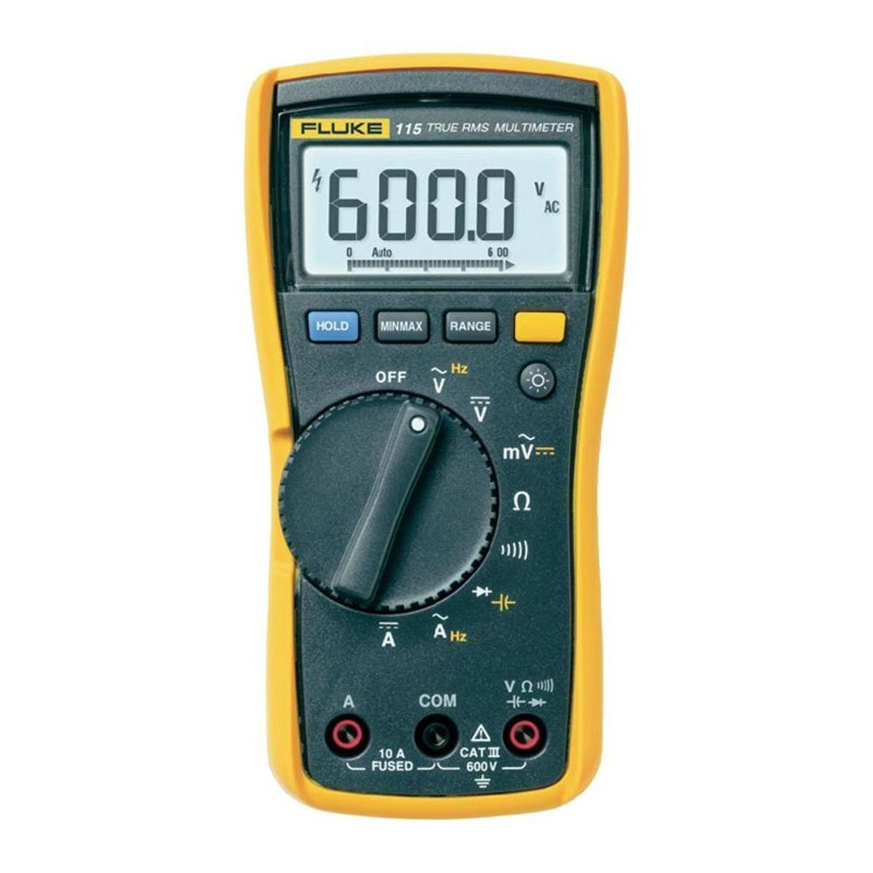
Multimeter
A multimeter, or multitester, is an electronic measuring device that combines several measuring functions in one device. A typical multimeter can measure voltage, current, resistance, capacitance and sometimes inductance.

Slide 48
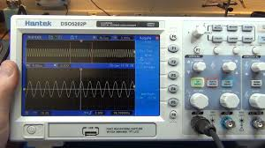
Oscilloscope
An oscilloscope, is a type of electronic device that graphically displays a variable signal voltage, usually as a calibrated, 2D diagram of one or more signals as a function of time. The waveform shown can then be analyzed for properties such as amplitude, frequency, rise time, time interval, distortions, and so on.

Slide 49
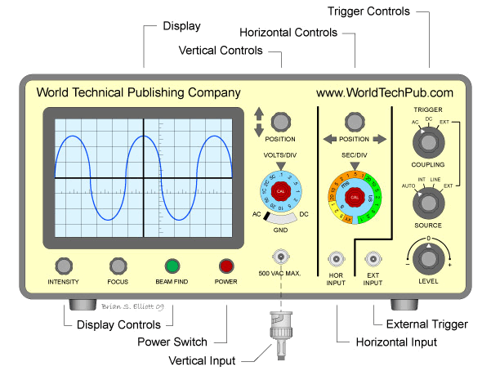
Oscilloscope

Slide 50
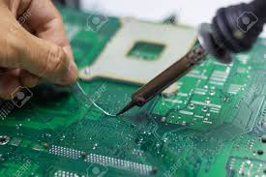
Soldering iron and its accessories
This device comes in many shapes and variations, but basically it is just a device with a certain resistance, the front of which heats up to a high temperature (0-500 degrees).
Using a hot part of the device, the contacts for soldering the component are heated and the required solder layer is melted on them (with the help of a soldering iron), which, when the soldering iron is removed, suddenly cools and hardens, thus forming a strong electrical contact.

Slide 51
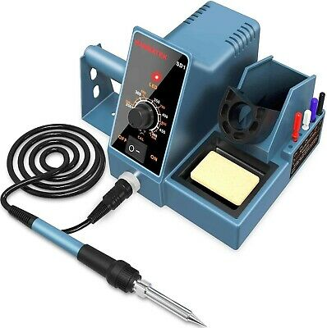
Soldering iron and its accessories

Slide 52
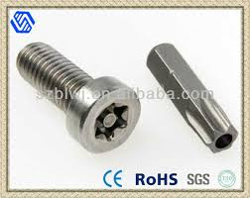
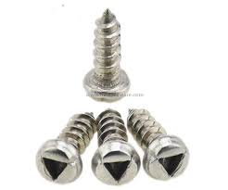
Precision screwdrivers
Because in many cases, when trying to repair, improve, or just see real diagrams, the device needs to be disassembled, its housing opened, so precision screwdrivers are an integral part of electronics.
Especially in these times, when there are an infinite number of different types of screws and many of them are designed specifically for protection against opening, so special screwdrivers of unusual shape are necessary.

Slide 53
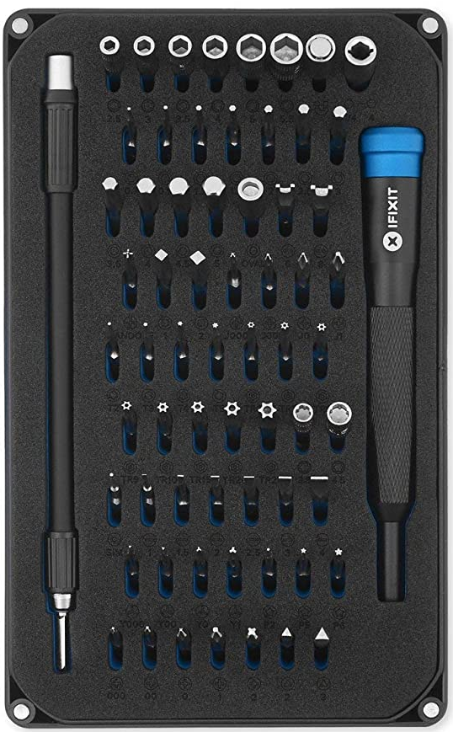
Precision screwdrivers

Slide 54
Goodbye

